Slide 1
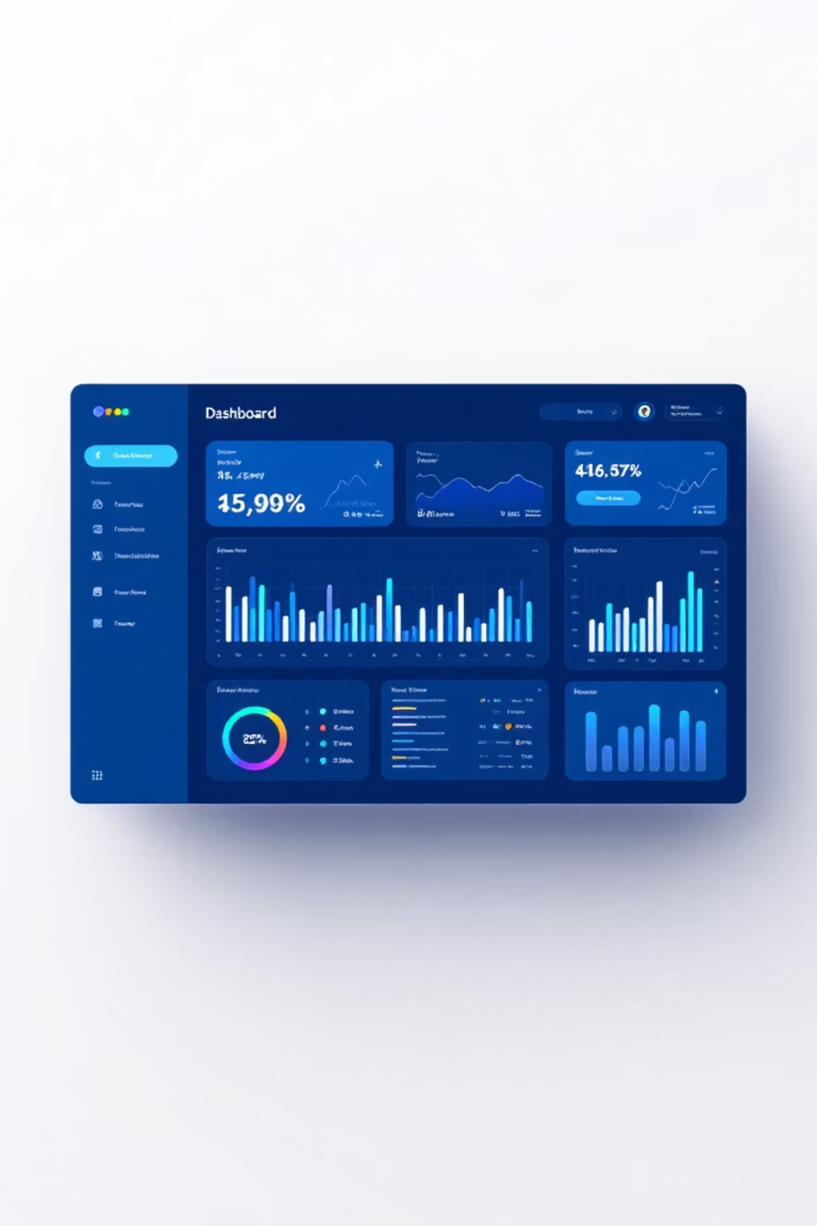
User Role Authentication
Smart Delivery Application
Role Implemented By: Mehek Fatima Shaik
Technology: Role-Based Access Control

Slide 2
Introduction to User Role Authentication
User Role Authentication is a security mechanism that ensures only authorized users can access specific features of the application based on their assigned role.
In this project, authentication is designed to:
Secure the system
Control access
Separate responsibilities clearly

Slide 3

Need for User Role Authentication
Unauthorized users may access sensitive data
Drivers may access admin controls
System security is compromised

Slide 4
User Roles in the System
The Smart Delivery Application supports two user roles:
🔹 Admin
System controller
Has full access
🔹 Driver
Delivery executor
Has limited access
Each role has separate permissions and dashboards.

Slide 5




My Responsibility in the Project
Role-based account creation
Secure login for Admin and Driver
Dashboard redirection based on role
Preventing unauthorized access

Slide 6
Account Creation Module
Role selection
(Admin / Driver)
Email and password registration
Driver-specific data (vehicle type)
Features:

Slide 7
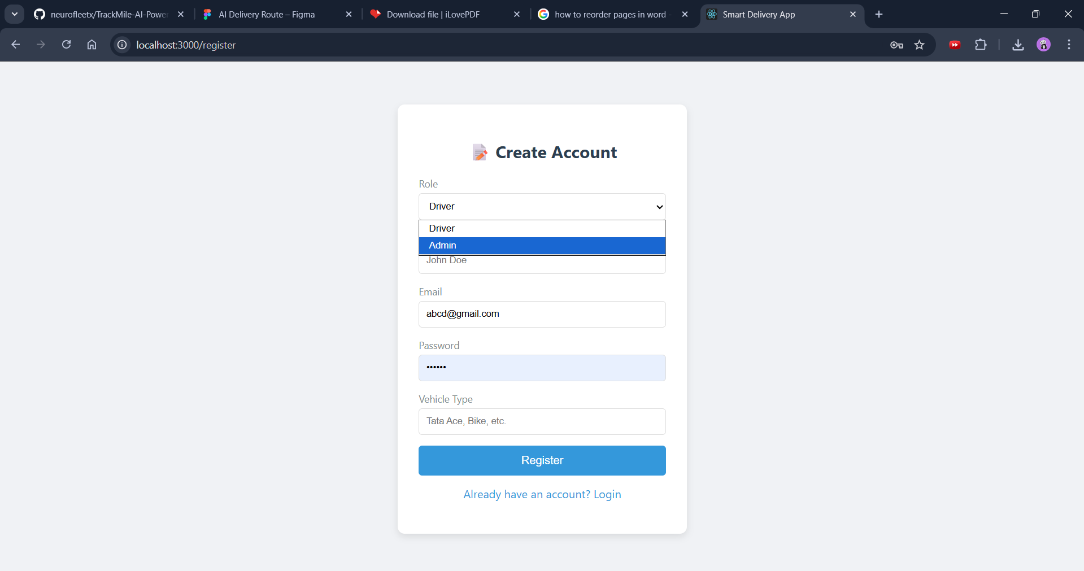

Slide 8
